Slide 1
SKYLOOP

Slide 2
Raise your hand if you’ve heard of drones before

Slide 3
Raise your hand if you want to fly a drone

Slide 4
Raise your hand if you think you would crash a drone if you piloted it

Slide 5
SKYLO P

Slide 6
Goals
Make a track for drones that is not only a recreational obstacle course but can also serve as a test in guiding and navigation for beginner pilots

Slide 7
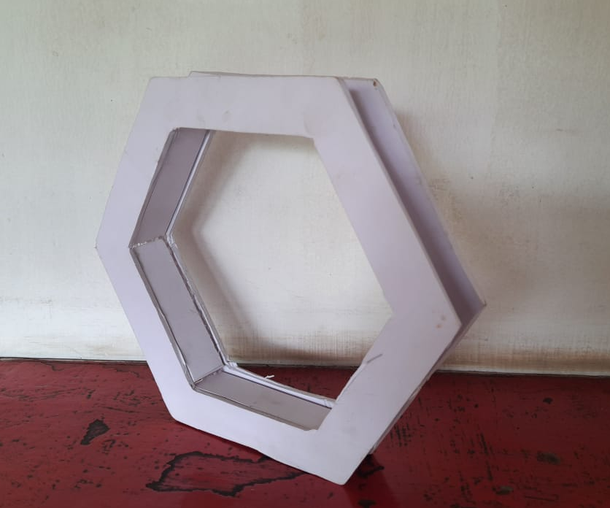
THE PROCESS - SUNBOARD
Dimensions: 24 x 3 x 3
Process of creation:
Step 1. Trace pencil sketch on sunboard
Step 2. Cut the hexagons out using a paper cutter
Step 3. Use fevi stick to join them together
Realisations:
We needed to devise a way for the structure to stick together better:
Solution: Notches at the top and bottom of each piece

Slide 8
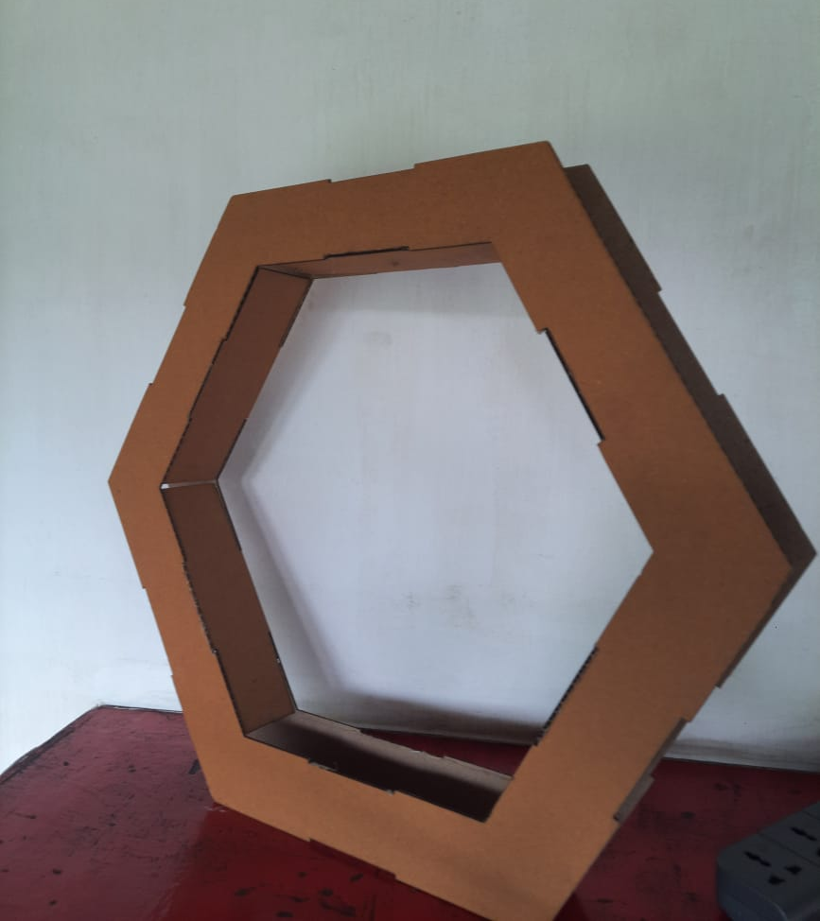
THE PROCESS - CARDBOARD
Dimensions: 48 x 6 x 6
Process of creation:
Step 1. Make a model of the pieces in Fusion 360
Step 2. Lasercut the pieces
Step 3. Use fevi stick to join them together
Realisations:
We needed a way to make holes for the lasers and buzzer
Solution: Holes in two out of the six interior pieces in the CAD model

Slide 9
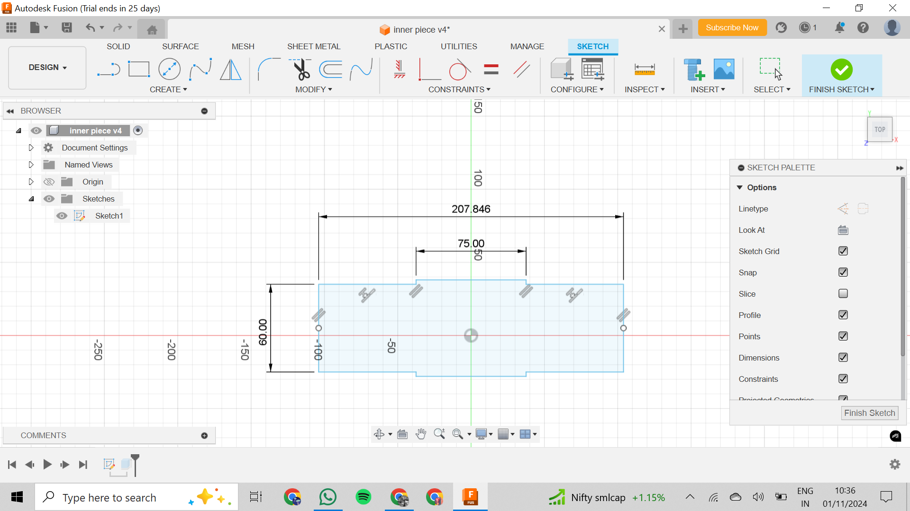
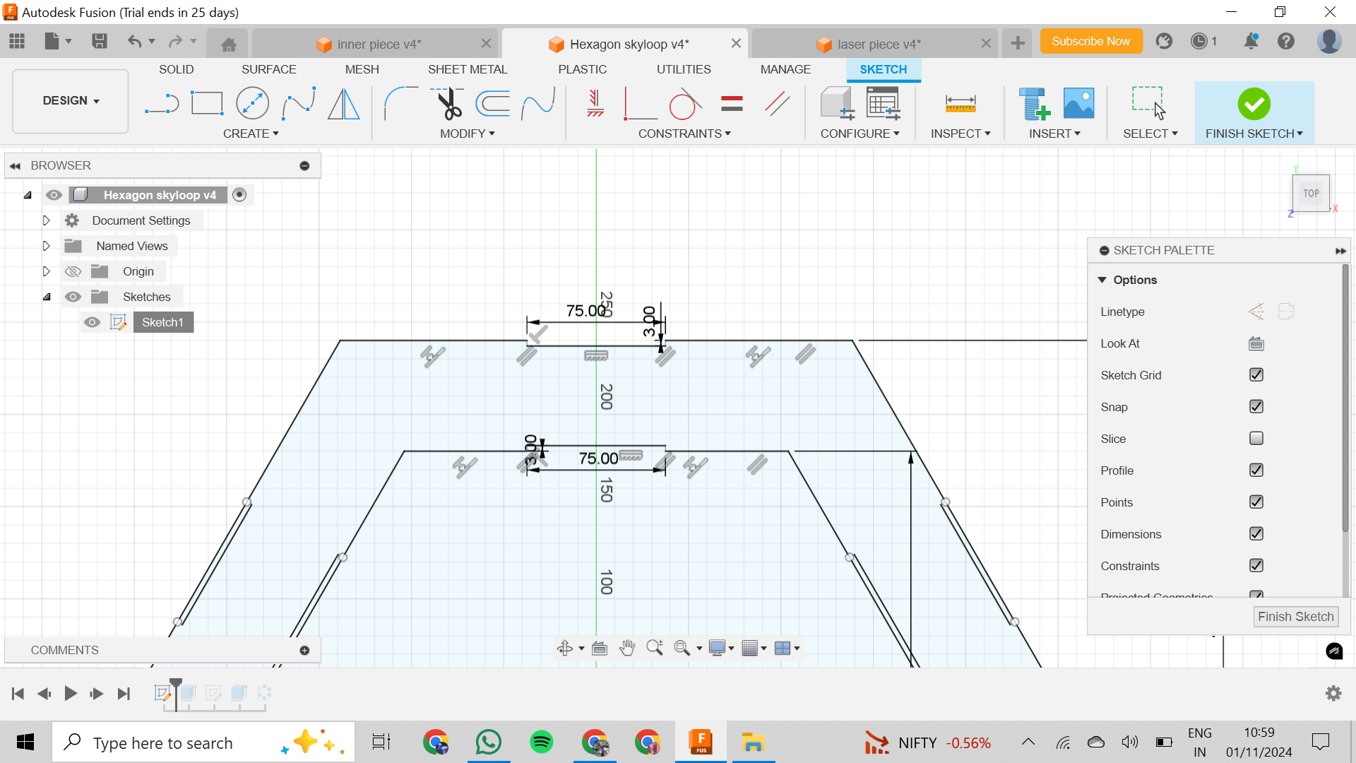
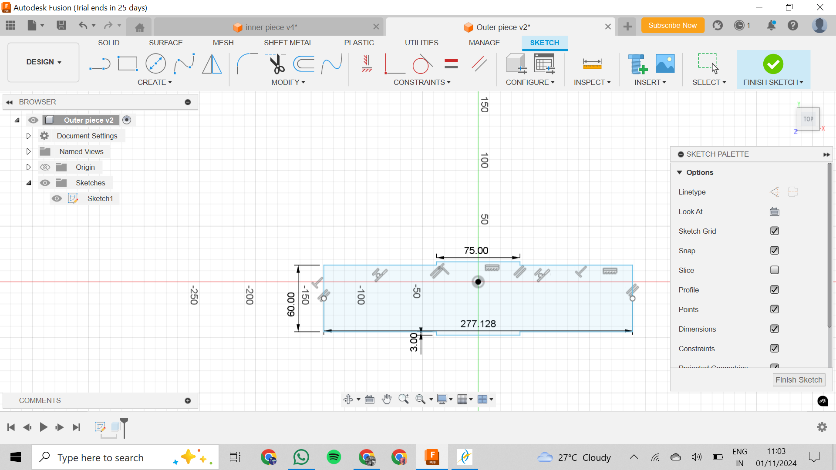
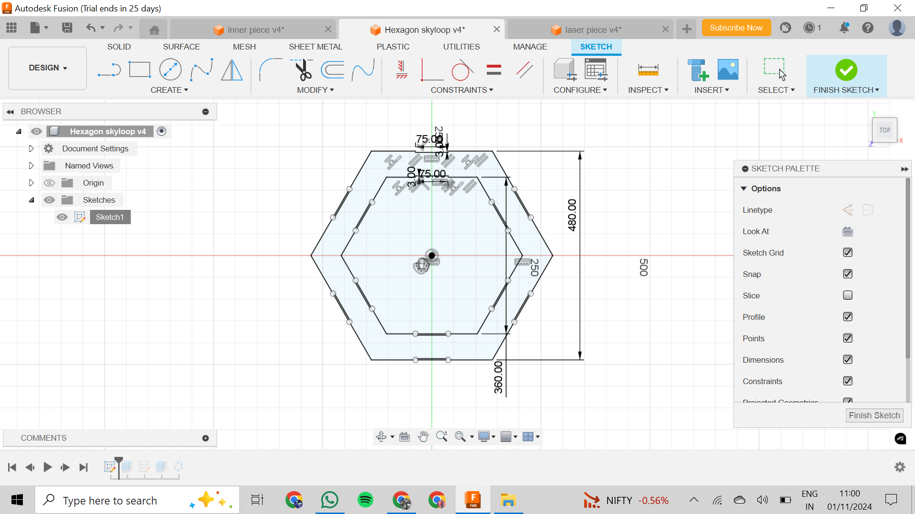
The Final Fusion Models

Slide 10
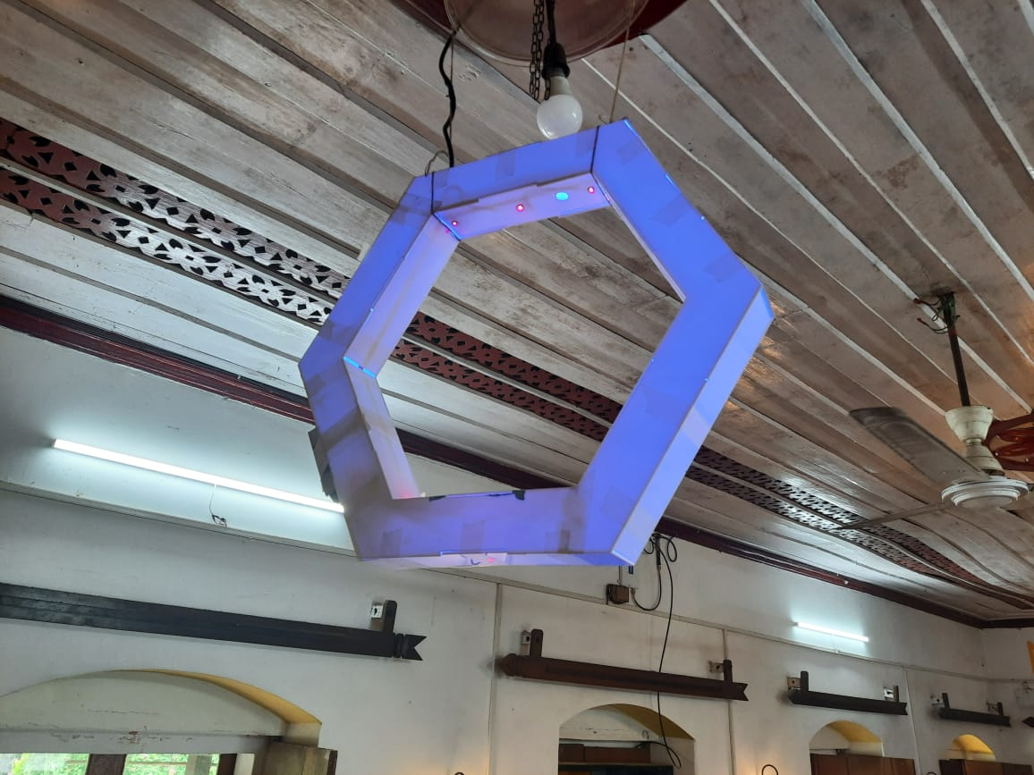
THE FINAL MODEL - ACRYLIC
Dimensions: 48 x 6 x 6
Process of creation:
Step 1. Make a model of the pieces in Fusion 360
Step 2. Lasercut the pieces
Step 3. Use fevi stick to join them together

